Slide 1



55th Wing Birthday Ball
RSVP Guide

Slide 2
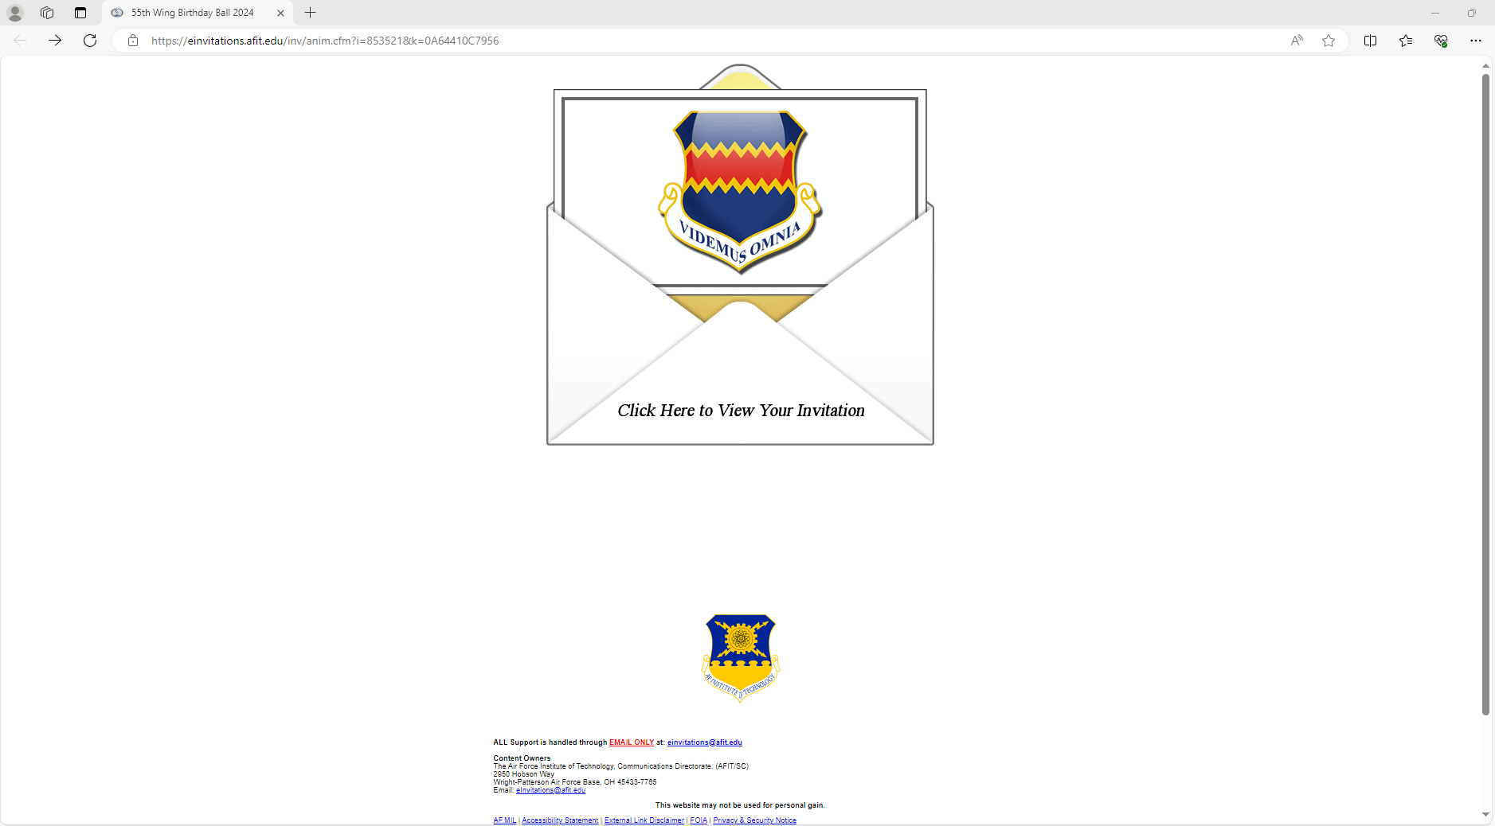
Step 1
Proceed to following link:
  https://einvitations.afit.edu/inv/anim.cfm?i=853521&k=0A64410C7956
  *NOTE* It is easiest to RSVP on a phone or non-government computer (which allows you to skip Step 5 – Part 1).
The page will look like this:
  Click where it says “Click Here…”

Slide 3
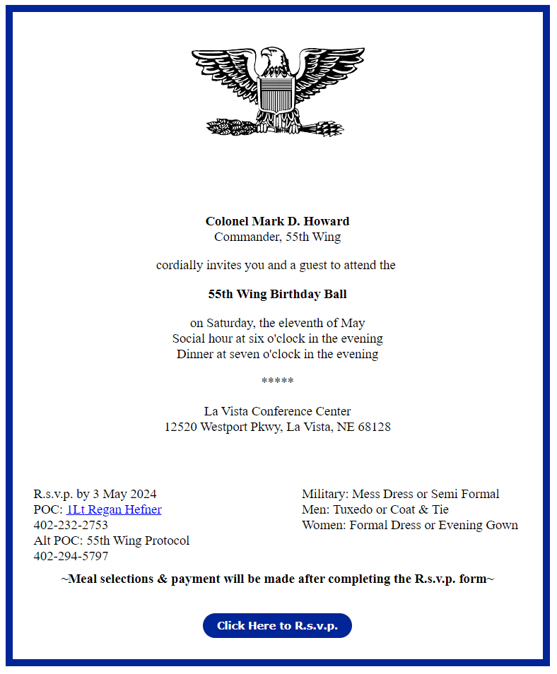
Step 2
That will take you to this page.
  Click on the blue “Click Here to R.s.v.p.” button.

Slide 4
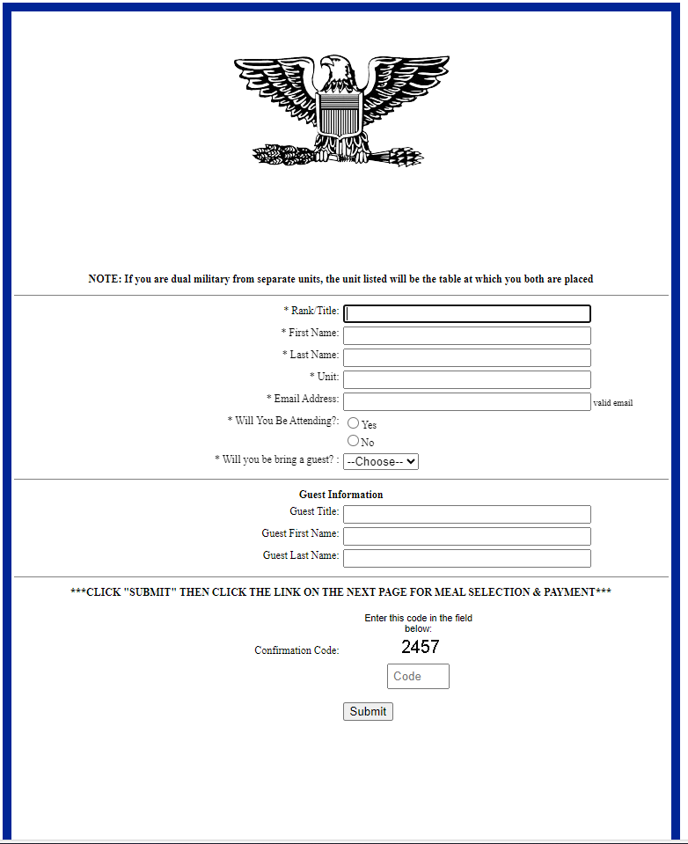
Step 3
Fill out the required slots.
If you have a guest, put their information here.
If your spouse is military as well, you will be placed at the squadrons table of whoever is at the top. If you wish to be with your own squadrons and separated, please fill out separate R.S.V.P.’s.

Slide 5
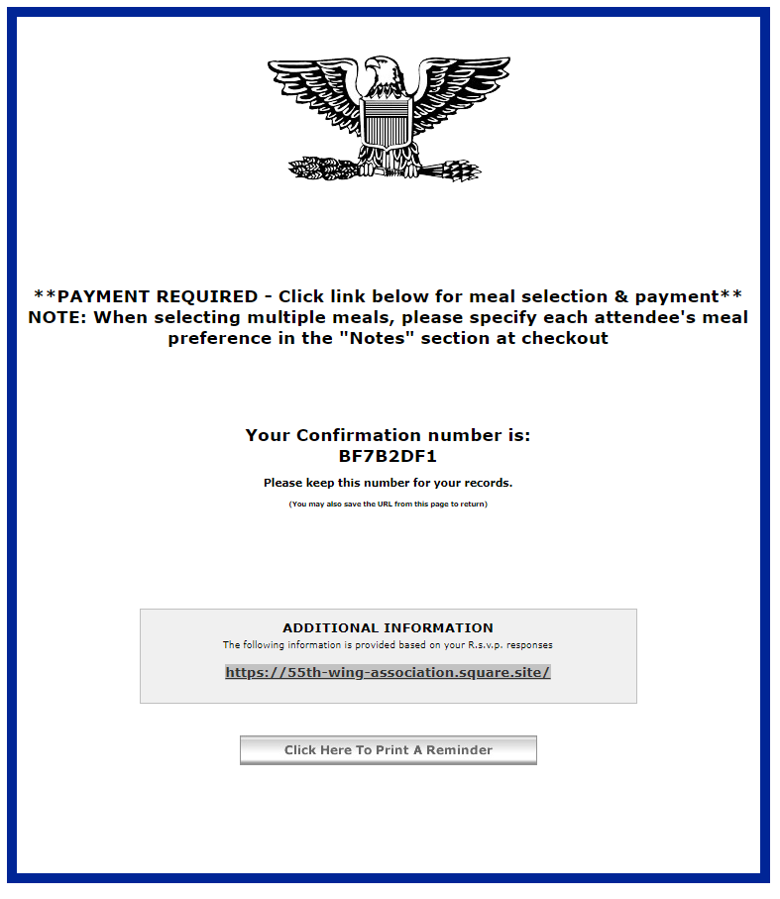
Step 4
Once submitted, you will be taken to this screen. Follow the link (circled) or see below.
(May only work in Chrome)
  https://55th-wing-association.square.site/

Slide 6
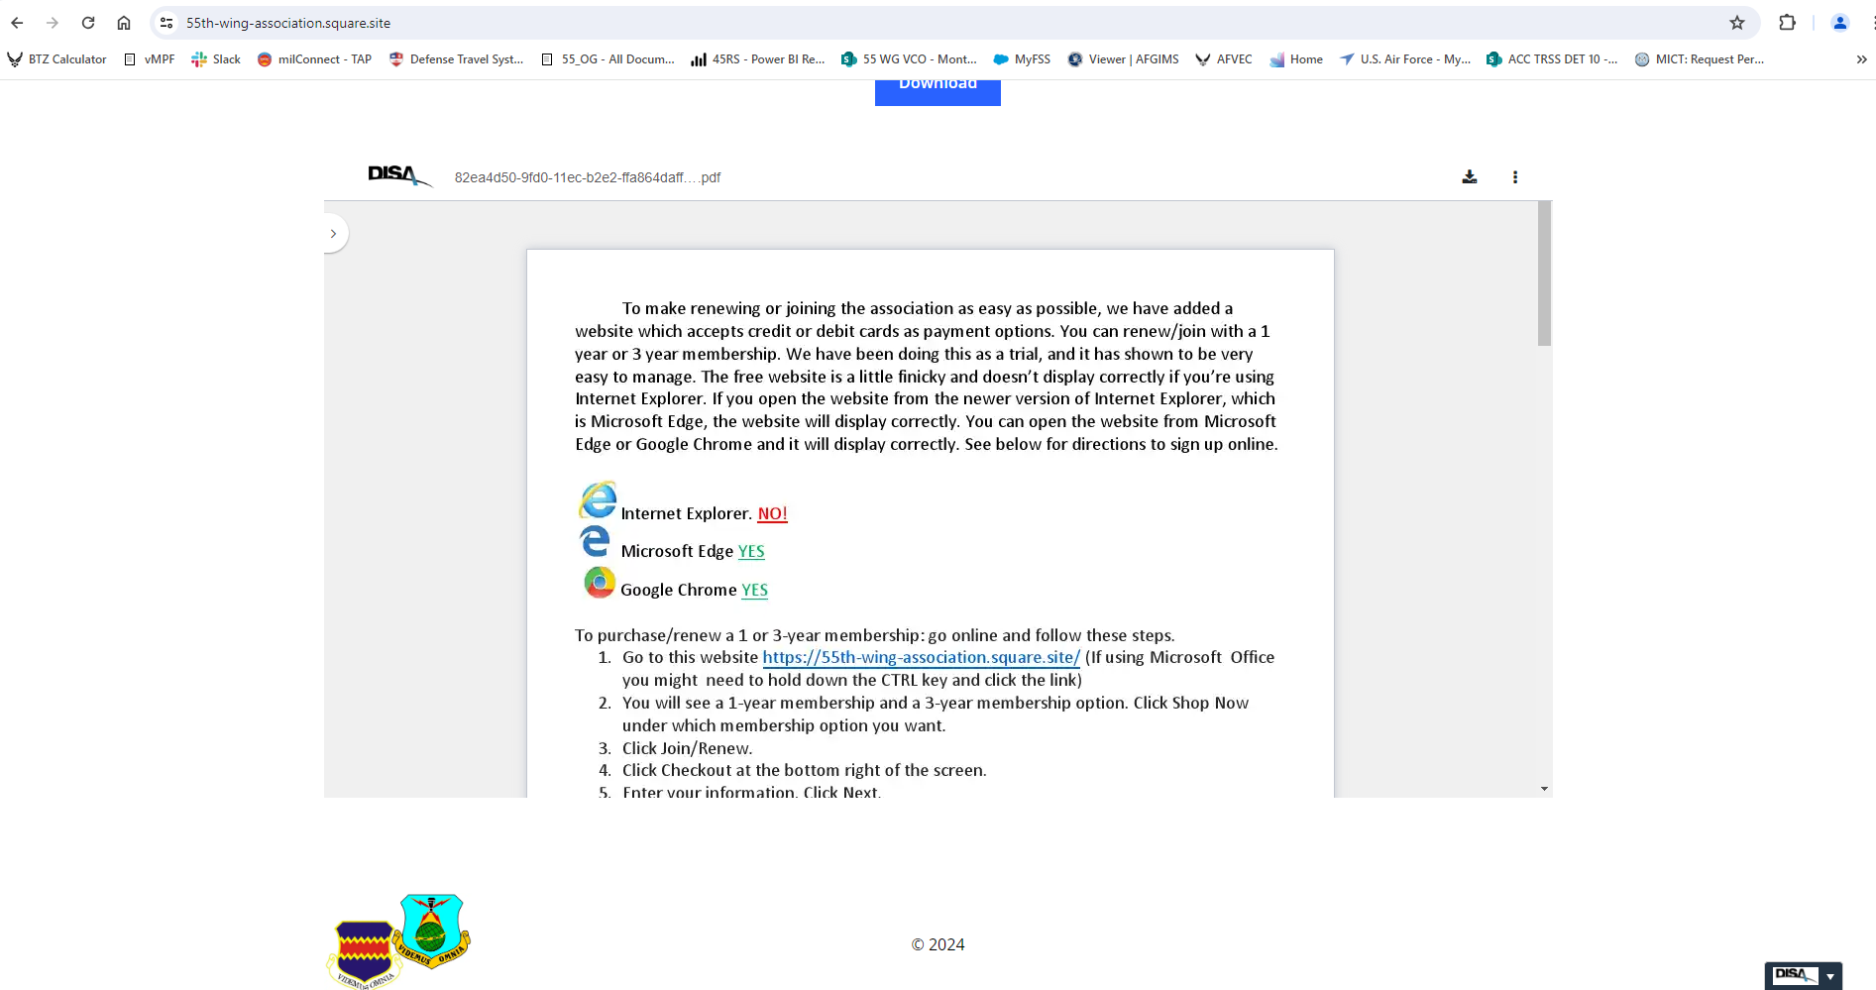
Step 5 – Part 1 (Where it start to get confusing, and slowwww)
Via a government computer the link will send you the bottom of the page, (as shown below). Simply scroll up to the top of the page.

Slide 7

Step 5 – Part 2
You should see a screen that looks something like this. Click on the blue “Shop Now” button (circled).

Slide 8
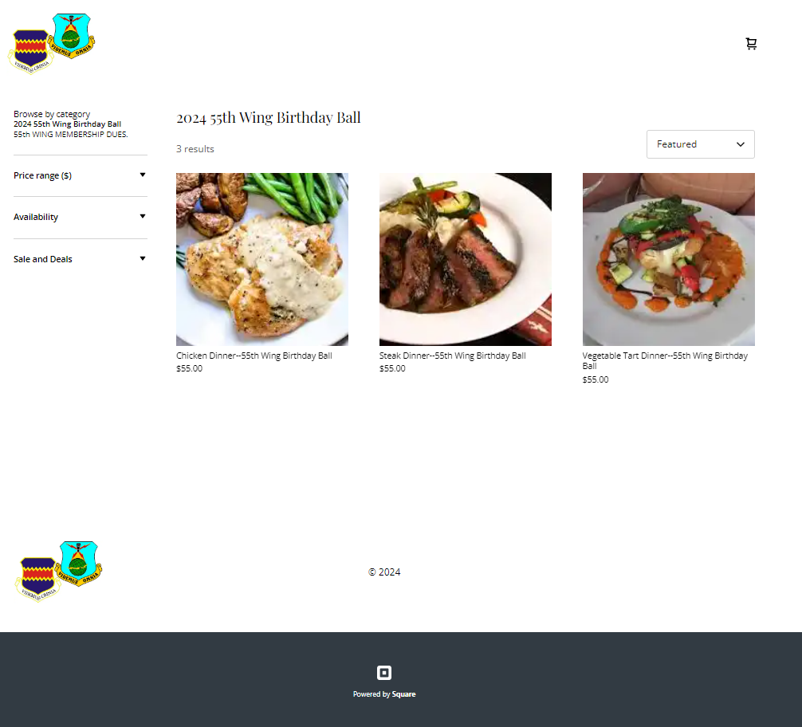
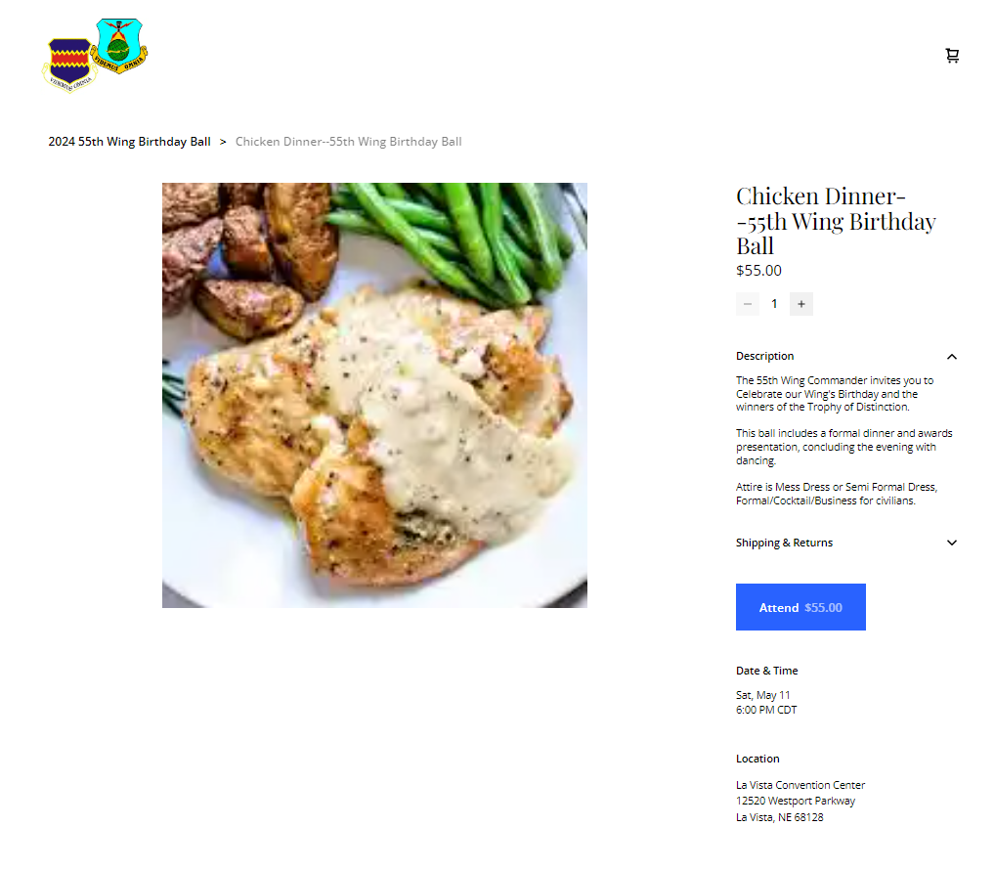
Step 6
From here, select the dishes you and your guests would prefer, then click the blue “Attend” button to add it to your cart. For multiple of the same dish, select the “-” or “+” symbols as circled in the bottom picture.

Slide 9
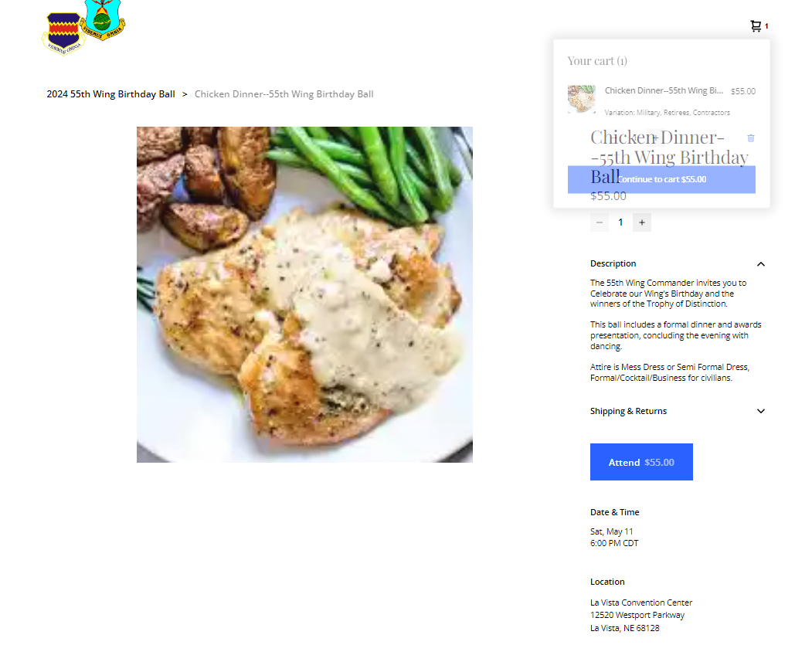
Step 7
Select the blue “Continue to cart” button on the pop up (Circled in green), or click on “2024 55th Wing Birthday Ball” (Circled in red) to add more meals.

Slide 10
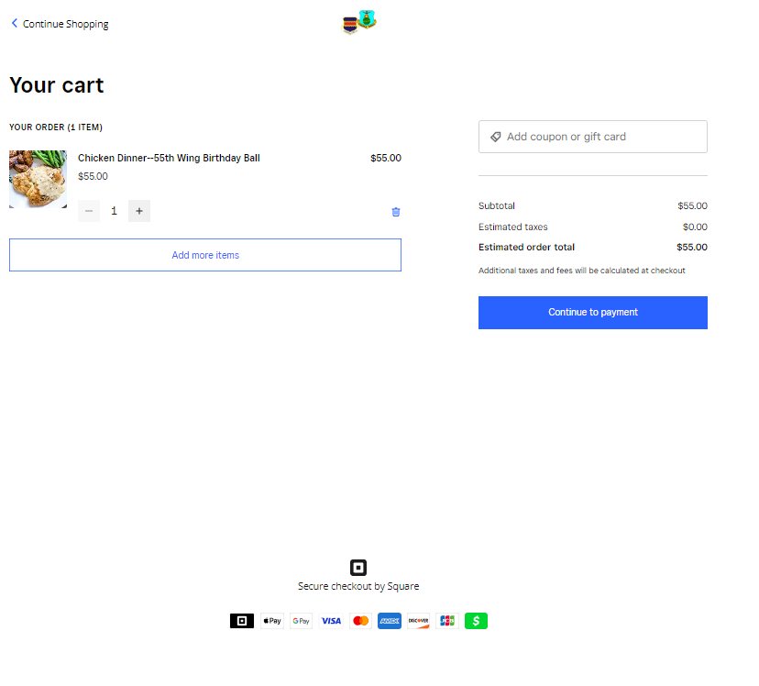
Step 7
Ensure all meals are correct.
Select “Add more items” if you need more meals.
If all is correct, select “Continue to payment”.

Slide 11
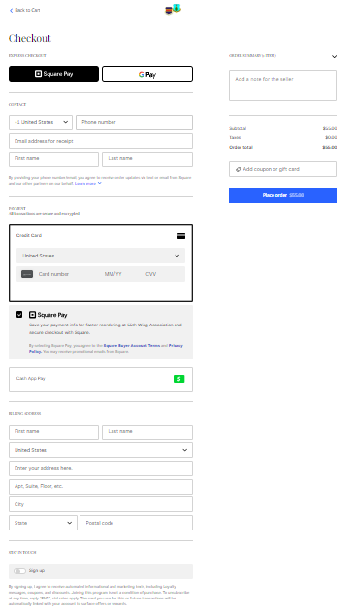
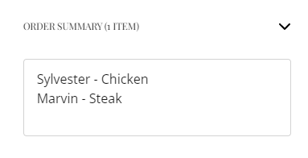







Step 8
Fill out payment method and billing address as required.
  May need to put your city in the first line for the autofill to find your address.
If you had multiple meals, you must input who got which meal in the “Add a note for the seller” box, example below.

Slide 12
Congratulations!!
You have successfully R.S.V.P’d for this years 55th Wing Birthday Ball!
Now, just add it into your calendar, and get your Mess Dress or Semi-Formal ready!
For any further questions, please reach out to your units’ POCs or, if not associated with a unit, the AO
  AO: Capt Regan Hefner regan.hefner.1@us.af.mil or 402-232-2753

